Slide 1
Fundamentals of Cyber Security

Slide 2

UNIT-4
Cyber Security - Organizational implications
Cyber Security - Organizational implications: Introduction, cost of cyber crimes and IPR issues, web threats for organizations, security and privacy implications from cloud computing, social media marketing: security risks and perils for organizations, social computing and the associated challenges for organizations.
Cybercrime and Cyber terrorism: Introduction, intellectual property in the cyberspace, the ethical dimension of cybercrimes, the psychology, mindset and skills of hackers and other cyber criminals.

Slide 3



Cyber Security - Organizational implication
UNIT-4
Security breach
Unauthorized acquisition of data that compromises security, confidentiality or integrity of personal information (PI).
Good faith acquisition of PI either by an employee or an agent of an organization for business purposes is not considered to be a breach, provided that the PI is not used or subjected to further unauthorized disclosure.
PI is information that is, or can be, about or related to an identifiable individual.
It includes any information that can be linked to an individual or used to directly or indirectly identify an individual.
PI can be any of the following data
Social security number (SSN)/social insurance number.
Driver’s license number or identification card number.
Bank account number, credit or debit card number with personal identification number such as an access code, security codes or password that would permit access to an individual’s financial account.
Home address or E-Mail address.
Medical or health information.

Slide 4


Cyber Security - Organizational implication
UNIT-4
Four key dimensions of Privacy:
Informational/data privacy
Personal privacy
Communication privacy
Territorial privacy
Key challenges from emerging new information threats to organizations:
1.Industrial espionage 2.IP-based blocking
IP-based “cloaking”
Cyberterrorism
Confidential information leakage
The consequences of cybercrimes and their associated costs:
Information loss/data theft (highest – 42%).
Business disruption (22%).
Damages to equipment, plant and property (13%).
Loss of revenue and brand tarnishing (13%).
Other costs (10%).

Slide 5







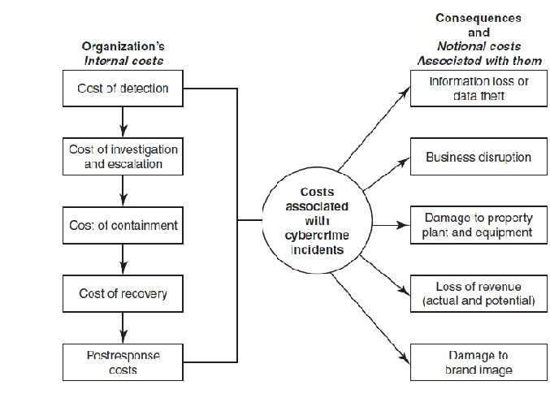
UNIT-4
Cyber Security - Organizational implication

Slide 6





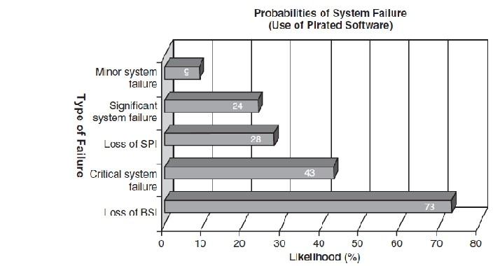
Cyber Security - Organizational implication
UNIT-4
Software piracy is an IPR violation crime.
Use of pirated software increases serious threats and risks of cybercrime and computer security. Violation of copyright laws (pirated software).
Knowing use is also a criminal offense under the Act.
Use of unlicensed software (pirated software) should be discouraged.
Vulnerability of nongenuine computer software.
Organizations should track software licenses to ensure that only genuine copies are used and that the number of installations is not more than the allowed number by establishing a software license tracker tool.

Slide 7







Cyber Security - Organizational implication
UNIT-4
Overview of Web Threats to Organizations
Large number of companies as well as individuals have a connection to the Internet.
Employees expect to have Internet access at work just like they do at home.
Mobile workforce has various categories.
Workforce mobility poses challenges for IT managers whose agenda is to protect the business and business assets against malware.
Protection of information assets is important; especially protection of removable/detachable media.
Categories of Web threats
Employees do a number of activities online (viz., visiting infected websites, accessing pornographic sites, responding to Spam mails and attempting to hack sites) to name a few.
There are many challenges and difficulties IT managers face when it comes to managing web use in a secure and efficient way and when it comes to handle an “incident” alert received.
Employee Time Wasted on Internet Surfing
Approximately 45–60 minutes spent on personal web surfing at work.
Safe Computing Guidelines/Internet Usage Guidelines should be implemented. 3.Organizations need software tools to track.

Slide 8


Cyber Security - Organizational implication
UNIT-4
Keeping Security Patches and Virus Signatures Up to Date
Updating security patches and virus signatures have now become a reality of life and a necessary activity for safety in the cyberworld!
Keeping security systems up to date with security signatures, software patches, etc. is almost a nightmare for management.
Not doing it properly exposes IT systems to unnecessary risk.
In-house web filters, policy engines, Spam and anti-malware systems need regular updates to stay effective.
Finding IT technicians with the right level of skill to manage these systems is another aspect of this problem.
Bandwidth Wastage Issues
Organizations have to pay for their bandwidth utilization. Under such a scenario, there is a concern when expensive bandwidth is wasted by non-work Internet use. With the rise of social networking and the trend toward social media marketing, streaming audio and video sites and TV-on-demand business, Internet connections are under severe strain. There are tools to protect organization’s bandwidth by stopping unwanted traffic before it even reaches your Internet connection.

Slide 9


Cyber Security - Organizational implication
UNIT-4
Mobile Workers Pose Security Challenges
Security concerns with Personal digital assistant (PDAs).
Association of RIM BlackBerries.
Mobile workers use those devices to connect with their company networks when they are on the move.
Challenges in Controlling Access to Web Applications
Presently, a large number of organizations’ applications are web based.
There will be more in the future as the Internet offers a wide range of online applications.
Employees often tend to use these applications to bypass corporate guidelines on security. Employees may use their personal E-Mail IDs to send business-sensitive information (BSI) for valid or otherwise reasons. These reduce IT department’s control over data and security.
More and more organizations are getting worried about employee access to webmail or instant messaging applications.
As the sophistication of online applications increases, this is going to become a significant problem.

Slide 10


Cyber Security - Organizational implication
UNIT-4
The Bane of Malware
Many websites contain malware. Such websites are a growing security threat. Although most organizations are doing a good job of blocking sites declared dangerous, cyberattackers, too, are learning Criminals change their techniques rapidly to avoid detection. The consequences of infection are severe compared with any kind of malware.
The Need for Protecting Multiple Offices and Locations
Delivery from multi-locations and teams collaborating from multi-locations to deliver a single project are a common working scenario today.
Most large organizations have several offices at multiple locations.
Protecting information security and data privacy at multiple sites is indeed a major issue primarily because protecting a single site itself is a challenge these days.
In a solo site scenario, anti-malware, web filtering and monitoring software are needed.
Additional effort is required with multiple sites, as all hardware and administrative overheads are multiplied!
For an Internet-based-hosted service, it does not matter how many E-Mail servers there are. However, with inhouse solutions, you do not have to pay an upfront capital cost for hardware and software followed by an unpredictable ongoing maintenance cost. Fixed fee per user is also an option to consider.

Slide 11










Cyber Security - Organizational implication
UNIT-4
Security and Privacy Implications from Cloud Computing
There are data privacy risks associated with cloud computing.
Basically, putting data in the cloud may impact privacy rights, obligations and status.
There is much legal uncertainty about privacy rights in the cloud.
Organizations should think about the privacy scenarios in terms of “user spheres.”

Slide 12















Cyber Security - Organizational implication
UNIT-4
Usage of social media sites by large business-to-business (B2B) organizations (Fig. ):
Facebook is used by 37% of the organizations.
LinkedIn is used by 36% of the organizations.
Twitter is used by 36% of the organizations.
YouTube is used by 22% of the organizations.
MySpace is used by 6% of the organizations.
Understanding Social Media Marketing
Most typical reasons why social media marketing is used to promote their products and services:
To be able to reach to a larger target audience.
To increase traffic to their website coming from other social media websites.
To reap other potential revenue benefits and to minimize advertising costs.
To build credibility by participating in relevant product promotion forums and responding to potential customers’ questions immediately.
To collect potential customer profiles.

Slide 13








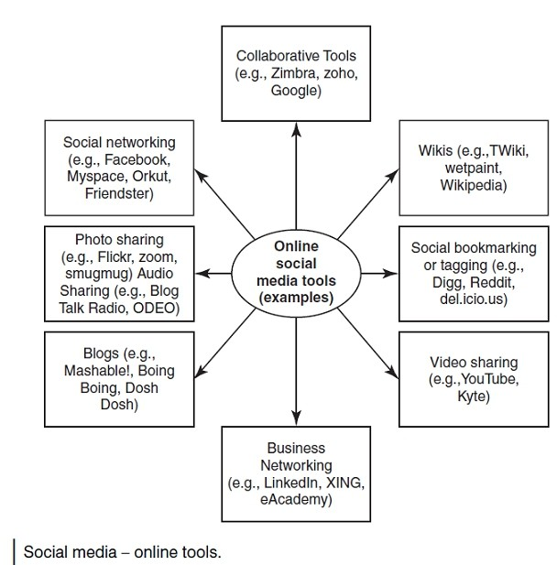
UNIT-4
Cyber Security - Organizational implication

Slide 14









UNIT-4
Cyber Security - Organizational implication
Best Practices with Use of Social Media Marketing Tools
Establish a “social media policy.”
Use of personal blogging for work-related matters should be monitored and minimized.
Use of policies and implementation of policy-based procedures are always essential.
Increasing employee awareness is an ongoing activity.
Organizations need to educate their employees about the risks associated with the use of online social media tool.
Organizations must raise their employees’ awareness of the fact that even seemingly innocuous information can reveal too much about the company or the person’s private life.
It is worth exploring appointment of a social media expert within the company.
Need to establish the “need-based access policy.”
Policies should not be treated as a one-time activity.
Blocking the infected websites is another necessary activity.
Access blocking can also be applied to any other suspicious site on the Internet.
Firewalls help to protect the organization.
Protection against vulnerability is possible by carefully planning vulnerability scanning and penetration testing.
An intrusion prevention system (IPS) serves as a protective barrier to the corporate network.
Securing the Intranets should also be included in the protection activities.
Include mobile devices in the security policy.
With the use of centralized management, administrators can manage, monitor and configure the entire network and all devices using a single management console.

Slide 15








UNIT-4
Cyber Security - Organizational implication
The Organizational Best Practices
Organization-wide information systems security policy
configuration/change control and management
risk assessment and management
standardized software configurations that satisfy the information systems security policy
security awareness and training
contingency planning, continuity of operations and disaster recovery planning
certification and accreditation

Slide 16













Cyber Security - Organizational implication
UNIT-4
Social computing (or “Web 2.0”): Empowers people to use Web-based public products and services.
It is much more than just individual networking and entertainment.
It helps thousands of people across the globe to support their work, health, learning, getting entertained and citizenship tasks in a number of innovative ways.
Social networking, social media marketing and social computing are not unrelated concepts.
Social computing is related to social media marketing.
Due care to be taken while using social computing as a channel strategy for communicating with internal or external stakeholders.

Slide 17







Cyber Security - Organizational implication
UNIT-4
World in this time of enormous technological development has many challenges in fight against phenomenon of cyber threats, especially cyber crime and cyber terrorism as a new forms of asymmetric threats in 21st century.
In order to protect security system by emerging threats – cyber terrorism and cyber crime, mainly on national than regional level, is needed to be taken appropriate activities.
Protection from cyber crime and cyber terrorism is related to protection on all spheres which have near points with that activities.
Reason for emerging this kind of threats is technological development, which brings certain changes in society and as a consequences are ICT penetration in all spheres in society.
Because of all previous mentioned reasons, cyber security should assist to be established mechanisms in fight against this kind of asymmetric threats not only in the region but also worldwide.

Slide 18







Cyber Security - Organizational implication
UNIT-4
Cyber Space:
One of the many national strategic objectives which should be written in Strategy of defense for countries in general term, it is cyber space protection in order to protect critical infrastructure and decreasing possibility of intrusion and cyber attacks but also reducing damage consequence caused by cyber attacks.
Furthermore it is necessary to emphasize that government services depend on cyber space in the meaning that they “fly” in that space, because they offer services in banking, finance, healthcare, information and telecommunication services and other fields.
The US Department of Defense (DoD) defines cyberspace as “a global domain within the information environment consisting of the interdependent network of information technology infrastructures, including the Internet, telecommunications networks, computer systems, and embedded processors and controllers.” (JP 1-02) (Wills, David, and Bunn, Sarah, 2006).
According to previously mentioned reasons, security in cyber space is most important because of permanent use of governmental services and increase of public trust in information systems. In order to accomplish aim, it is necessary to establish new level of communication and cooperation not only between governmental agencies and departments but also government and private sector (G2B).

Slide 19


Cyber Security - Organizational implication
UNIT-4
Mentioned above affords to conclude that is necessary to protect national critical infrastructure from intrusion and cyber attacks for the reason that hackers and other intruders can firmly use critical infrastructure as tool to perform their attacks. Optimal communication in cyber space is significant in order to exchange information between linked governmental institution. High-quality connections between institutions affords accelerate detection in addition to solve IT problems, known as viruses or other types of cyber attacks.
IT infrastructure through strong control security mechanism is a ”first step” to sharing information in timely, efficient and reliable manner. Security policy and strong secure mechanisms meet the requirements of sharing sensitive data which affords to government authorities to give quick answer, next make right decision and coordinated activities in critical situation.

Slide 20





Cyber Security - Organizational implication
UNIT-4
Cyber Crime:
Cyber crime encompasses any criminal act dealing with computers and networks. Additionally,cyber crime also includes traditional crimes conducted through the Internet. For example; hate crimes,telemarketing and Internet fraud, identity theft, and credit card account thefts are considered to be cyber crimes when the illegal activities are committed through the use of a computer and the Internet (Forno, F.R., 1998).
Some attacks in cyber space do not have certain targets, because attacks against computers or group of computers are becoming more common. Home users of computers, organizations either private or governmental can and their information technology networks can be target of attackers. Moreover, attackers using computers can cause damage to Critical National Infrastructure (CNI) that includes emergency services, energy distribution, health, finance and anything which depends of IT. Many IT systems which were isolated from the internet, now they are connected to internet and level of their violability become bigger.

Slide 21




Cyber Security - Organizational implication
UNIT-4
There are two main ways by which computers can be involved in crime (Schudel, Gregg, and Wood, Bradley, 2000)
Old crimes conducted using computers as a tool: for example storage of illegal images on a hard disk instead of in print; harassment using mobile telephones or illegal downloads of
music and other forms of piracy. Another example is ‘phishing’: confidence tricks involving spoof emails and fraudulent websites to acquire sensitive information. (Freeh, J.L., 1998)
New types of crime made possible by specific technologies. One example is denial of service attacks or DoS which prevent computer resources being available to intended users, for example by flooding web servers with more data than they can process, thus forcing websites offline. Other crimes involving attacking a computer (often by ‘hacking’ or
gaining unauthorized access to a computer system), or writing a virus (a type of malicious software or ‘malware’) to delete stored data. (Freeh, J.L. 1998)

Slide 22














Cyber Security - Organizational implication
UNIT-4
Hacker groups are numerous and they are divide each other by the level of education in technological field. Membership in a high level educated hacker groups frequently can be limited and exclusive membership is allowed only for individuals who develop and share set of sophisticated information communication tools for hacking. This “exclusive” hacker groups make efforts to be cover and not to attract attention due to confidentiality allows them to be more effective.
Although some hacker groups can be a globally dispersed, they have similar aims as a political interest or they are connected through another basis as a religious or social ideology. Other groups can be motivated from profit which comes together with organize crime. Also it is possible to meet hacker groups which are guided from their aspiration to sell their computer skills to sponsors as a terroristic groups or countries which it is depend on emerging political interest.
As a conclusion should be stated that there are numerous reports on the above, where the actors appear as governments, companies, associations and other stakeholders. On the same manner, it should be stressed that connection between hackers, terrorist and nations that support terrorism is very hard to prove it. On other hand activities that are caused by the cyber terrorist can be detected through carefully monitoring social networks, chat, mirc and other cyber virtual location where anonymously hackers meet to exchange their information.
Nevertheless, in order to prevent and avoid damages from terrorist and crime activities are developed numerous research projects which should give contribution to find out technology, tactics, techniques and other stuff associated to cyber threats.

